Slide 1


Database management and engineering JSPD- 303
SL. NO. | Roll No | Full Name | Academic Group
1 | 2023JULB01063 | Abhishek Padhy | 4
2 | 2023JULB01105 | A Malavika
3 | 2023JULB01388 | Kilari Teja
4 | 2023JULB01170 | Raj Singh
5 | 2023JULB01339 | Sweety Singh
6 | 2023JULB01281 | Yashdeep Singh

Slide 2
Tata Motors- Car Lifecycle Management database with focus on manufacturing
Selected Organization: Tata Motors
Business Process Being Modeled:
Customer Management: Capturing customer details like name, address, contact information, and purchase history.
Sales and Inventory Management: Tracking sales transactions, inventory levels, and dealer information.
Manufacturer and Supplier Management: Managing relationships with manufacturers, suppliers, and brands.
Vehicle and Model Management: Recording vehicle details, models, features, and manufacturing information.
Financial Analysis: Analyzing sales data, customer income levels, and average transaction values.
Dealer Operations: Managing dealer locations, inventory levels, and sales activities.
This system facilitates efficient management of the entire car lifecycle, from manufacturing to sales and customer support.

Slide 3
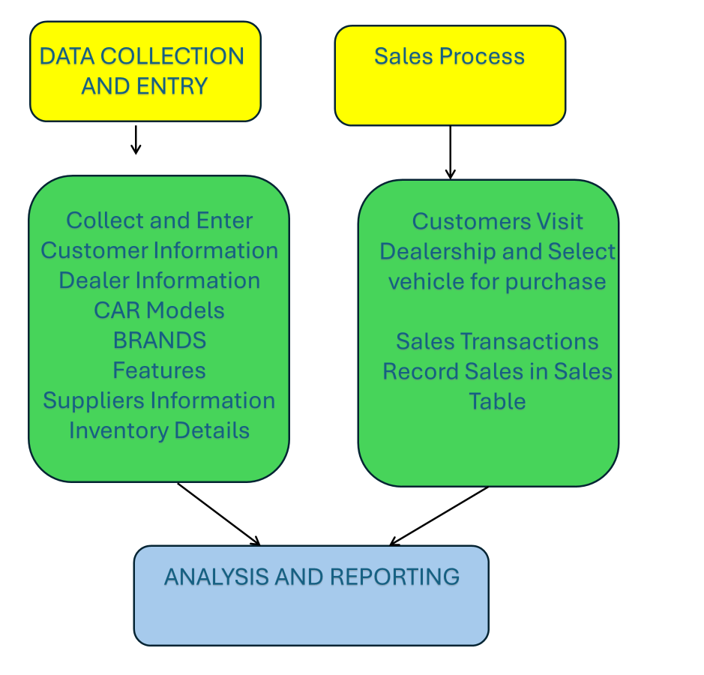
Data flow chart

Slide 4
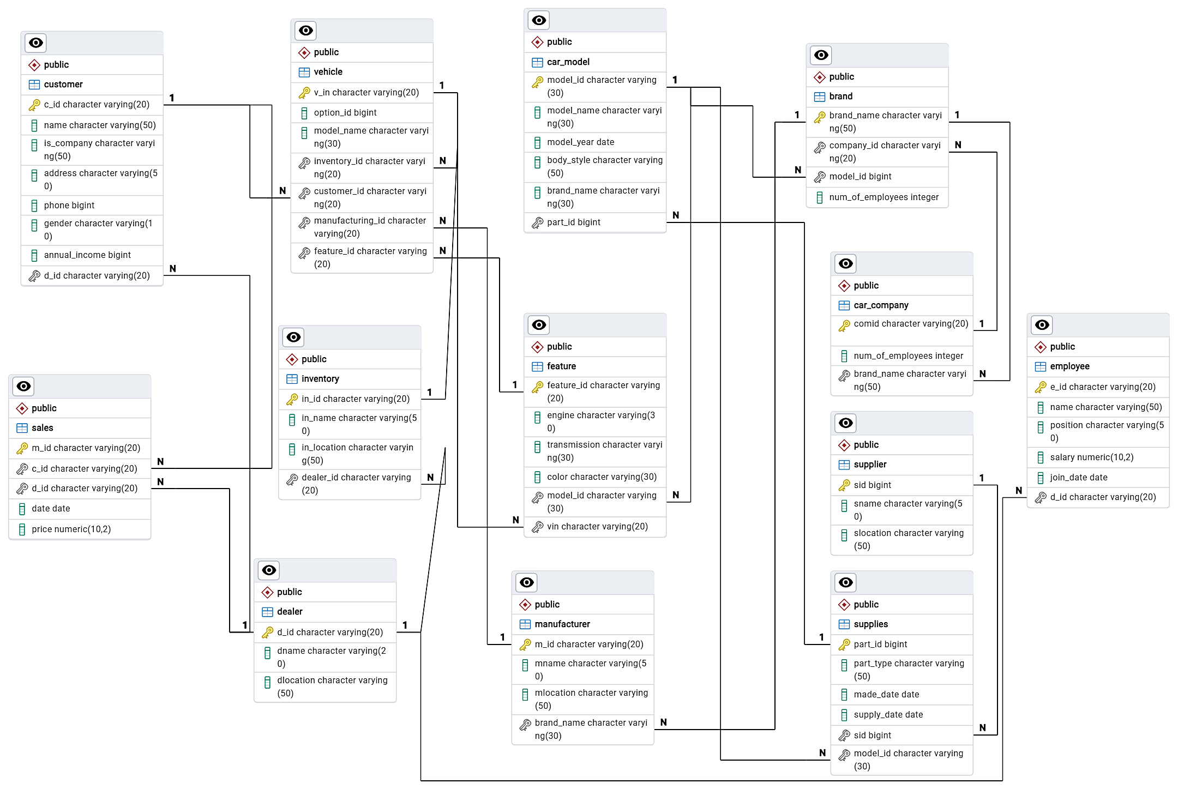
ERD DIAGRAM

Slide 5
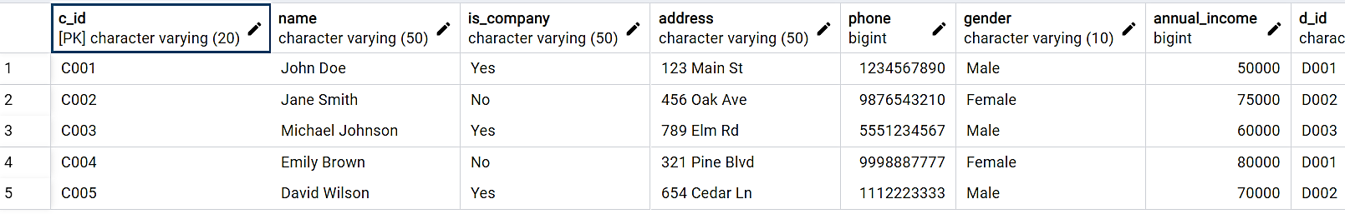
Show tables
SELECT *
FROM Customers;
CUSTOMER TABLE

Slide 6
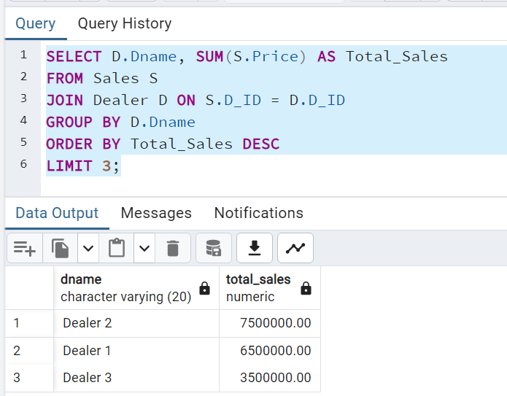
Test case 1: Sales performance of dealers
This query analyzes the sales performance of dealers by calculating the total sales amount and showing the top 3 performing dealers.

Slide 7
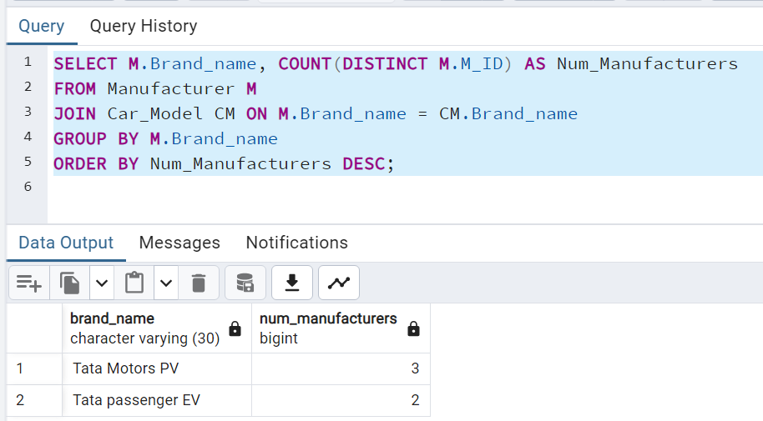
Test case 2: Manufacturer comparison
This query compares the number of manufacturers for each brand based on the car models they produce.

Slide 8
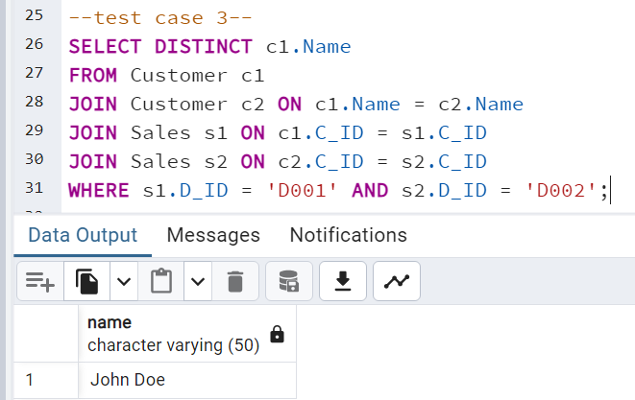
Test case 3: get names of customers who made purchases from both dealer 1 and 2
SQL Query-- Get the names of customers who made purchases from both Dealer 1 and Dealer 2--
SELECT DISTINCT c1.Name
FROM Customer c1
JOIN Customer c2 ON c1.Name = c2.Name
JOIN Sales s1 ON c1.C_ID = s1.C_ID
JOIN Sales s2 ON c2.C_ID = s2.C_ID
WHERE s1.D_ID = 'D001' AND s2.D_ID = 'D002';

Slide 9
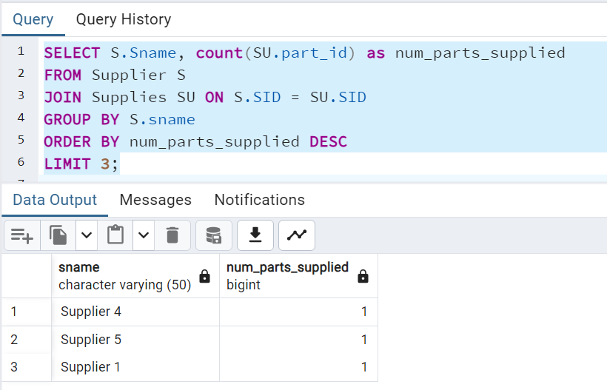
Test case 4: Supplier inventory check
This query checks the inventory of suppliers by counting the number of parts they supply and showing the top 3 suppliers.

Slide 10
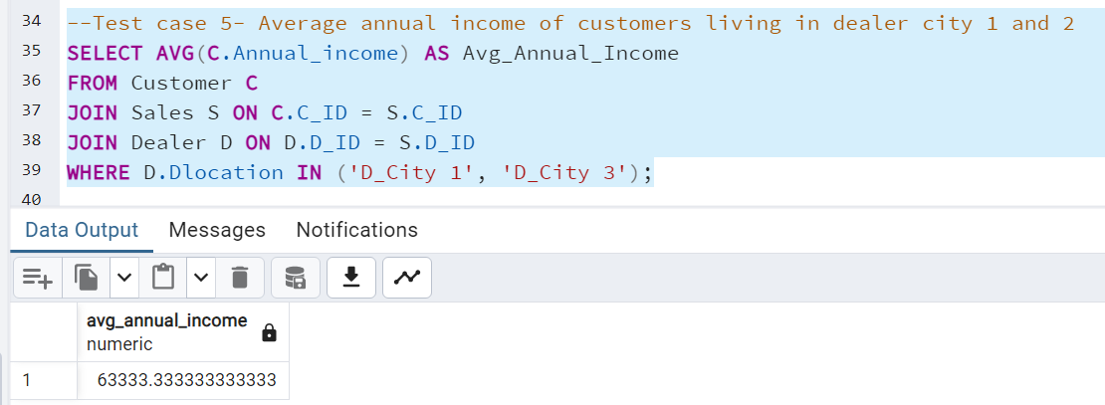
Test case 5: Average income of customers
Calculate the average annual income of customers who purchased from dealer in city 1 and city 3

Slide 11
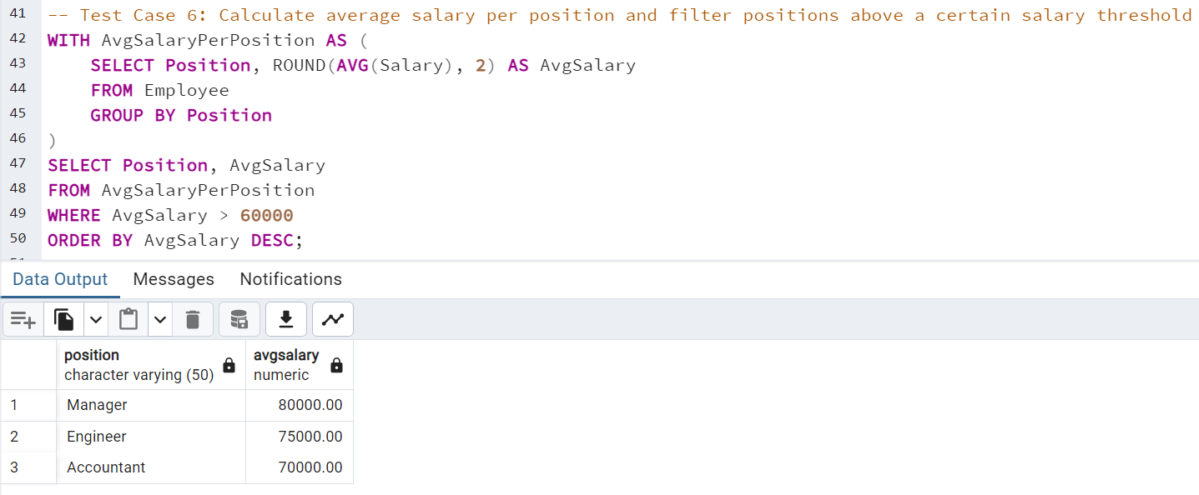
Test Case 6: Average salary of employee per position

Slide 12

Thank You

